Slide 1


U.S. EPA Criminal Enforcement Update
2023
This presentation does not represent, and should not be construed to represent, any formal or informal EPA determination, policy or regulation. This presentation may not be relied on to create any rights, substantive or procedural, enforceable by any party in litigation with the United States.

Slide 2
Organization of EPA Criminal Program
Utilizes agents from the Office of Criminal Enforcement, Forensics and Training (OCEFT), within the Office of Enforcement and Compliance Assurance (OECA) in EPA-Headquarters
  New York Area Office supervised by a Special Agent in Charge (SAC) for both Region 1 and Region 2
  Satellite agent offices in Syracuse, Buffalo, Edison, San Juan
  New Haven office also works cases in New York City
Regional Criminal Enforcement Counsel (RCECs) are Regional attorneys in Office of Regional Counsel
  Legal support in Region 2, two full-time RCECs in New York, 1 part-time in New York and one part-time in San Juan

Slide 3
Region 2 Current Case Docket

Slide 4
Open Cases June 2021
Open Cases Now

Slide 5
Sentencing since June 2021
Sentenced 11 individuals or companies
Incarceration:
  Five years of incarceration in U.S. v. Andrecola (FIFRA & Title 18)
  10 months in U.S. v. Laskin (an asbestos case)
  8 months in U.S. v. Landell (related asbestos case)
Criminal fines
  Act to Prevent Pollution from Ships (APPS) case $250,000
  Aiding and Abetting violations of TSCA--$15,000
Restitution
  $ 399,783 to augment recovery for sites addressed under Superfund
  $207,363 in restitution for sale of unregistered pesticides
Over $ 20,000 in costs to be paid for medical monitoring

Slide 6

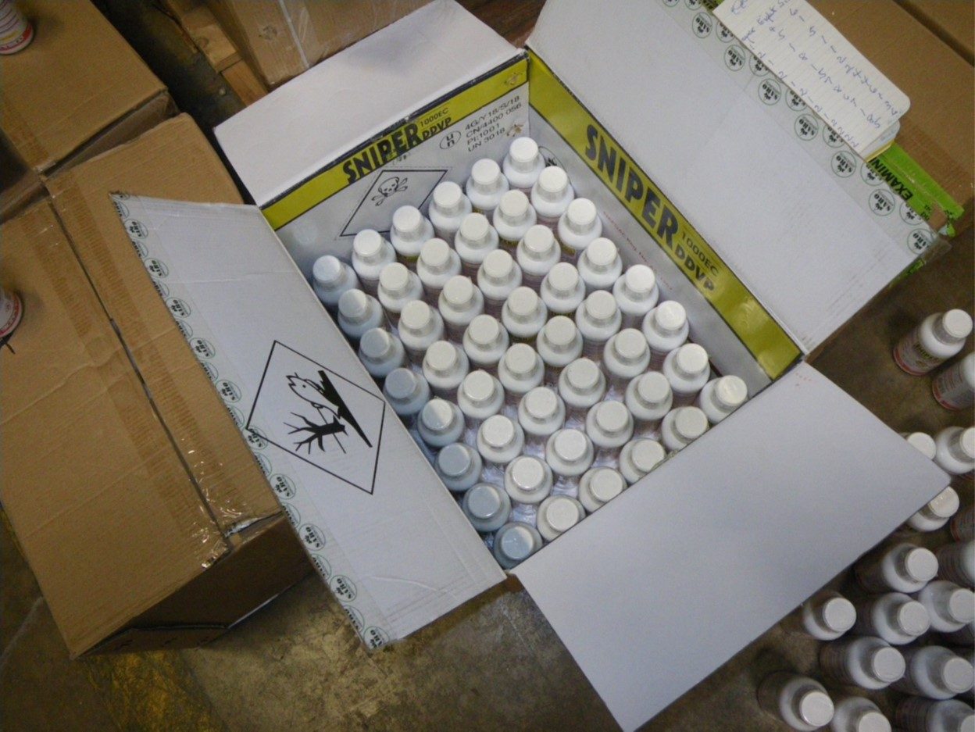
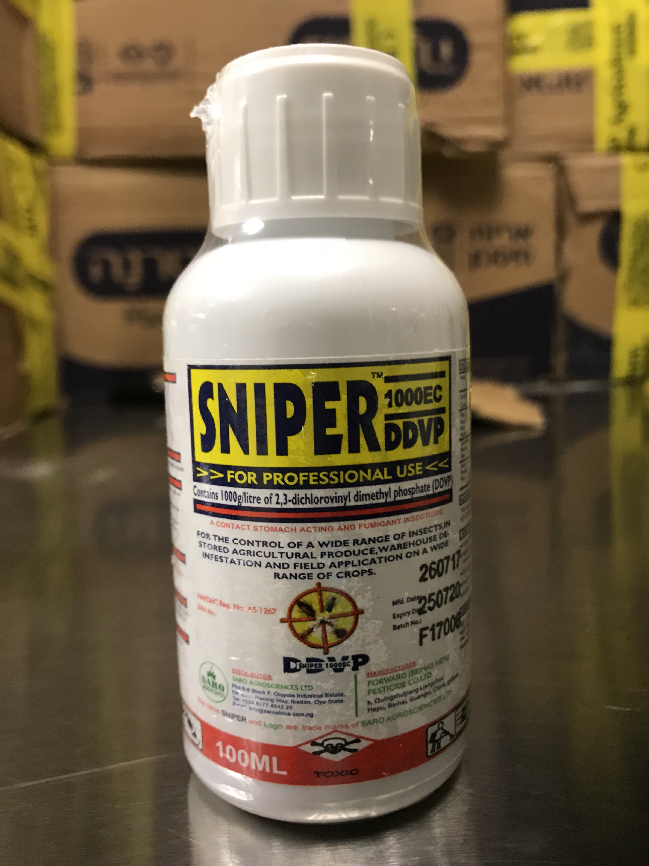
Federal Insecticide, Fungicide & Rodenticide Act (FIFRA) cases
Covid Products
Unregistered pesticides on the internet
Illegal import of pesticides

Slide 7
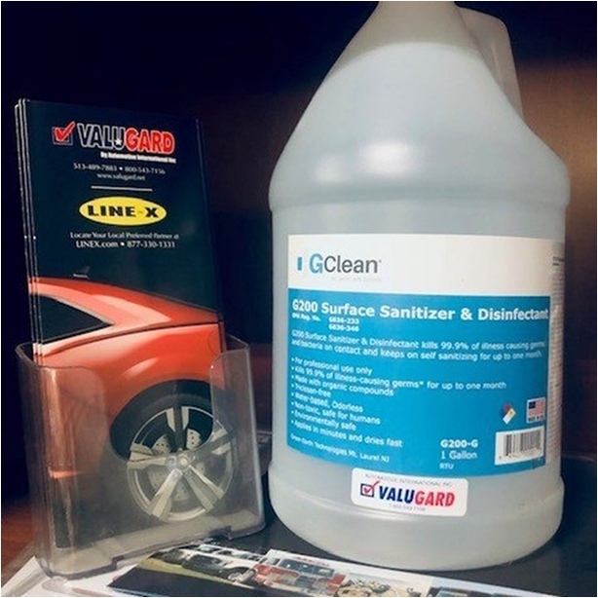
United States v. Andrecola – COVID Fraud case (DNJ)
Inventek/Green Earth Technologies manufactured, distributed, and sold GCLEAN GC200 in liquid and wipe form
GC200 is not a registered pesticide in accordance with FIFRA
Enforcement timeline
  September 2020: Federal Search warrant executed an Inventek/Green Earth facility
    EPA Agents recovered invoices of a significant amount of sales of GCLEAN products
    Labels claiming that GCLEAN products are EPA Registered
  November 17, 2020: EPA civil personnel issued an advisory letter to Inventek/Green Earth pertaining to sale of GL200
    Indicating that sale and distribution of unregistered or misbranded pesticides is not in compliance with FIFRA
  May 2021: Second search warrant executed at the facility
    Information showing continued sales of GCLEAN products, which were still not registered

Slide 8
Andrecola charged on June 8, 2022
FIFRA: unregistered pesticide sales
Wire Fraud: more than $2.7 million in sales
False Statements to the Federal Government

Slide 9
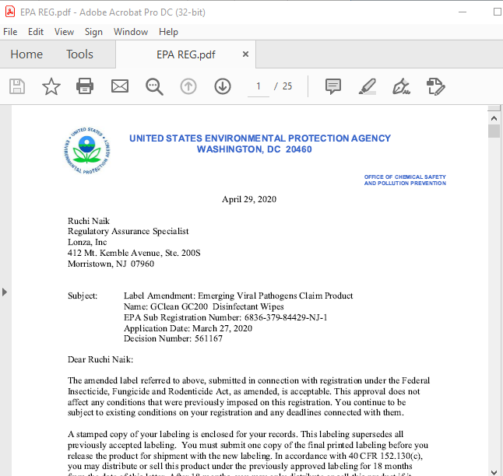
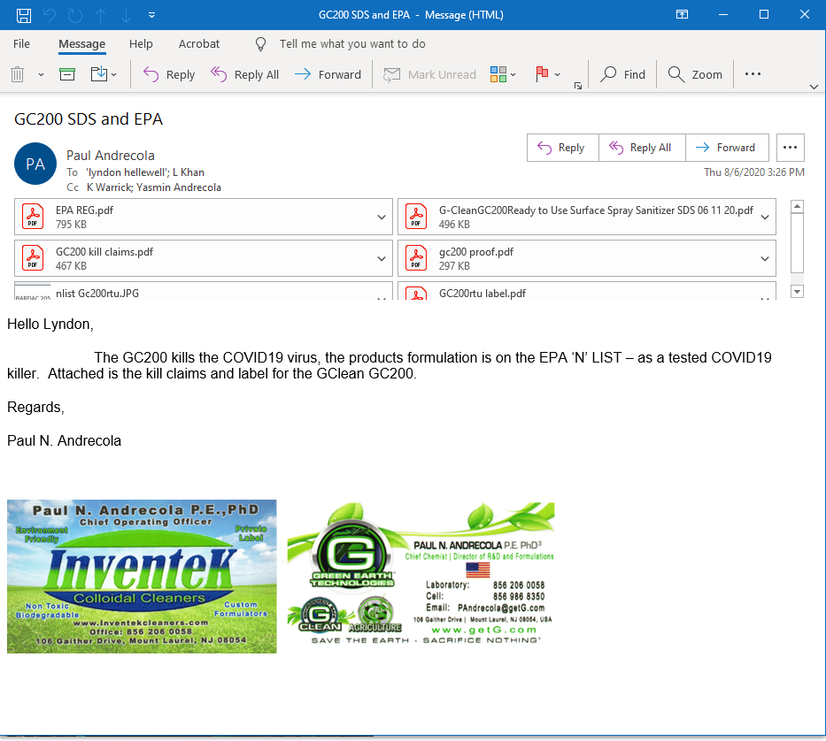




Fraudulent Sales Process and Misrepresentation of Product

Slide 10
Victims: Direct and indirect
Medical and Dental Facilities: Children’s Hospital, VA Hospital
Schools and Colleges
Fire Departments
Law Enforcement Agencies
United States Military/Agencies: FAA, Federal Bureau of Prisons, Department of Treasury, HUD, U.S. Customs and Border Protection, Federal Protective Services, Department of Homeland Security, Internal Revenue Service
State Government/Agencies
Native American Tribes

Slide 11
December 2022 – Federal Sentencing
Five years incarceration, followed by 3 years supervised release
  FIFRA (12 months)
  Wire Fraud (60 months)
  False Claims (60 months)
Forfeiture
  $2.7 million Forfeiture Order
Restitution
  Government provided list of victims and amounts subject to restitution
  Restitution of $207,363,30
April 2023 -Restitution Hearing

Slide 12
Lead abatement/RRP cases under TSCA
Consistent with efforts to lead poisoning in children
Currently have significant investigations in multiple jurisdictions
TSCA Felony provision added to the statute in 2016 for imminent danger of death or serious bodily injury:
  “Any person who knowingly and willfully violates any provision of section 2614 or 2689 of this title, and who knows at the time of the violation that the violation places an individual in imminent danger of death or serious bodily injury, shall be subject on conviction to a fine of not more than $250,000, or imprisonment for not more than 15 years, or both.”
15 U.S.C. § 2615(b)(2)(A)
Region 2 indicted the first case in the U.S in August 2021
  Case will be going to trial in July in the Eastern District

Slide 13
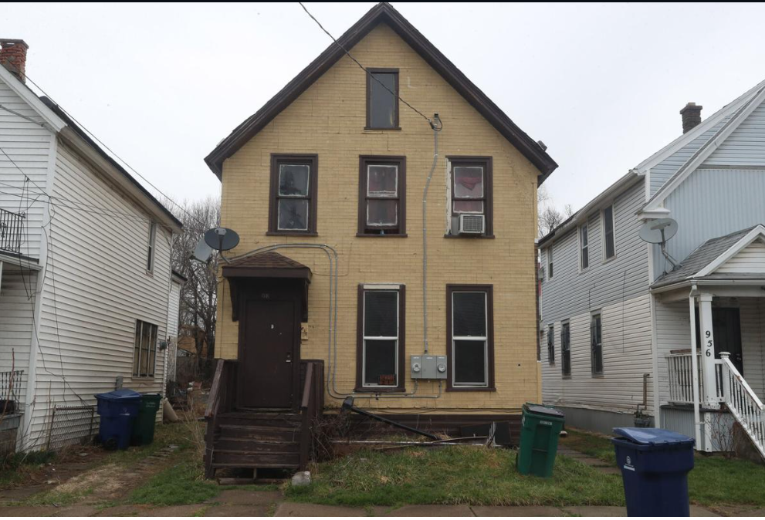
United States v. Dalfin and Heil (WDNY)
Dalfin is a property owner in Buffalo
Heil was his property manager, agent, and close associate
From 2007- 2020, Dalfin-owned companies owned approximately 157 properties
Of these, 63 had been cited for lead-based paint violations
Properties located in neighborhoods with median income < $20,000
TSCA requires disclosure of known lead hazards to renters or buyers
Notes:
.

Slide 14
United States v. Dalfin and Heil (cont’d)
Rental of housing
  Tenants in housing with violations received no lead disclosures or received false lead disclosures
  23 children with elevated blood lead levels linked to this housing
Sale of housing
  Became aware of a State civil investigation
  Consolidated almost all of the properties in another company, of which he is the sole member
  Sold many properties to unsuspecting buyers, failing to disclosure the lead hazards
  Continued selling properties after he had been directed by the State court to stop

Slide 15

Paul Heil
Criminal complaint filed against Heil and Dalfin in May 2021 for conspiracy to commit
  Wire fraud
  Conspiracy
Heil’s first court appearance was in June 2021
On March 8, 2022, Heil pleaded guilty to a one-count misdemeanor
  Aiding and Abetting the Failure to Provide a Lead Paint Hazard Warning Notice
In June 2022, he was sentenced
  Heil sentenced to a criminal fine of $15,000 and
  one year probation

Slide 16
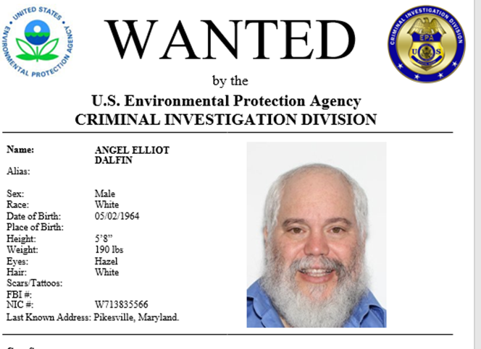
Dalfin, meanwhile, was a fugitive
The same criminal complaint was filed against Dalfin in May 2021
EPA-CID sought him for over a year
Ultimately, he self-surrendered in July 2022
Plea agreement entered by Dalfin in April 2023
  One count felony of making & using a false document, 18 U.S.C. 1001(a)(3)
Sentencing is in September
  Sentencing is likely to be in 12 to 18 months
  With a criminal fine of up to $55,000
  Court will also require restitution up to $115,000 to purchasers of properties he sold

Slide 17
Questions?
Report an Environmental Violation
http://www2.epa.gov/enforcement/report-environmental-violations
Patricia C. Hick
Acting Deputy Regional Counsel/Regional Criminal Enforcement Counsel
Office of Regional Counsel
U.S. EPA Region 2
hick.patricia@epa.gov

